Slide 1

By Lolla Mahidhar(mahidharlolla@gmail.com)
Business Analyst Career Program - Capstone Project

Slide 2

Agenda
Data Exploration
Statistical Analysis using Excel
Graphical Analysis using Excel
Insert the given data into the SQL server
Import the Data from the SQL Database into PowerBI
Interactive Dashboard by using visualization tools
Conclusion and Inferences
Endnotes

Slide 3
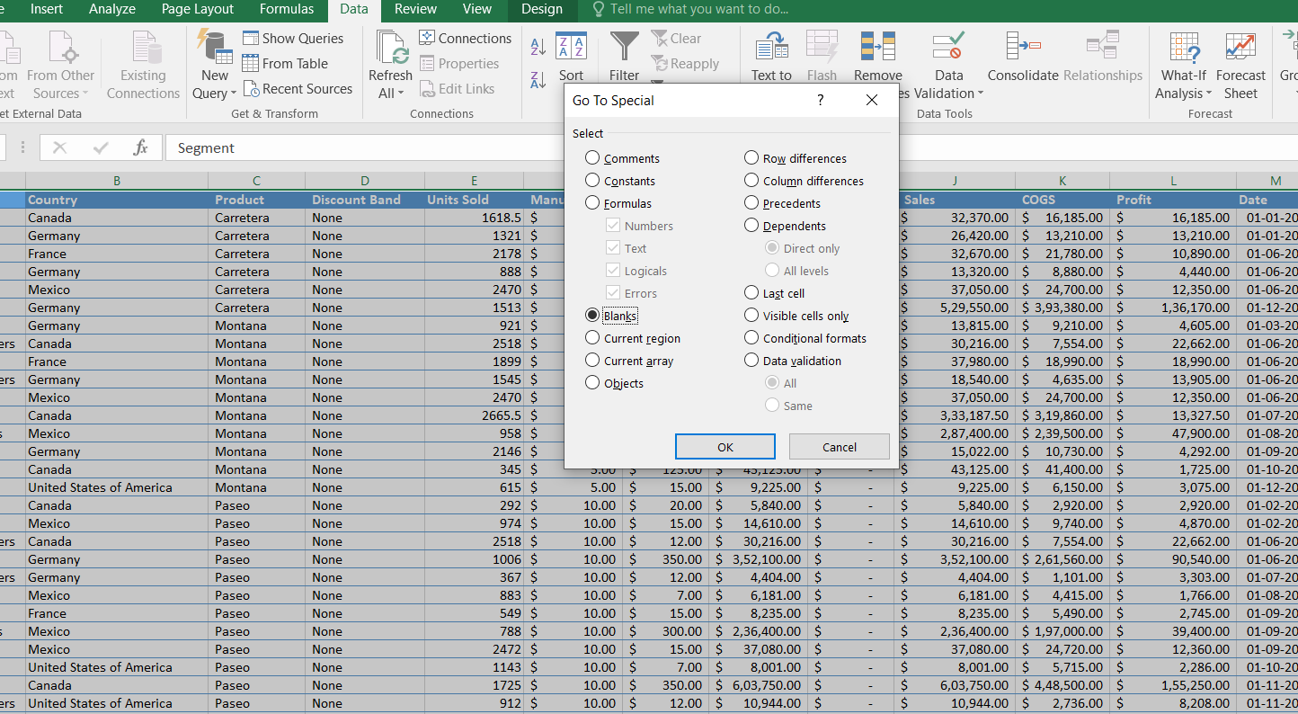
Data Exploration
Dataset Overview
Number of Rows: 700
Number of Columns: 16
Columns Description:
Segment, Country, Product, Discount Band: Categorical data providing descriptive information.
Units Sold, Manufacturing Price, Sale Price, Gross Sales, Discounts, Sales, COGS, Profit: Numerical data.
Date, Month Number, Month Name, Year: Time-related data for analysis over time.
Key Observations
The dataset is complete with
no missing values in any column.

Slide 4
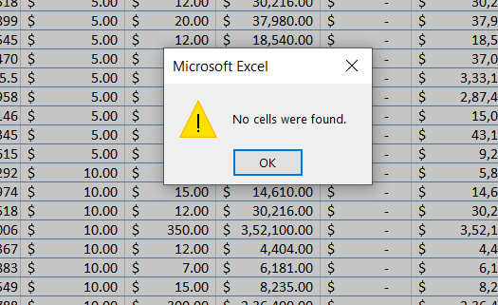
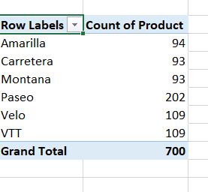
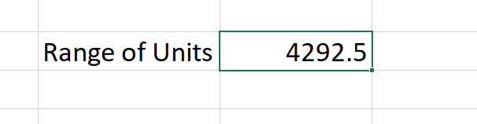
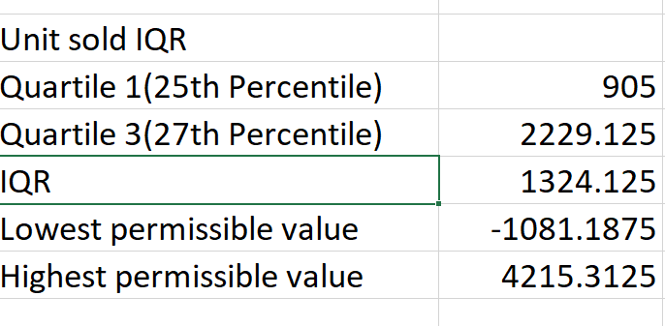
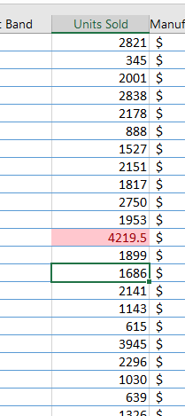
Data types are appropriate for their respective columns (e.g., numerical for sales metrics, date time for dates).
The dataset spans multiple segments, countries, and products, making it suitable for diverse analysis (e.g., profit trends, sales comparisons).
Some common and simple exploratory questions and their answers as below:
· Which product or segment has the most data entries?
Created a pivot table setting the rows and values both to the product/segment and then analysed the count of the product in descending order as shown below.
· What’s the range of "Units Sold" or "Profit"?
• Are there unusual values or outliers?
Used IQR for identifying the outliers or unusual values
Now using conditional formatting of greater than or lesser than, we can identify any outlier values above highest permissible value and lowest permissible value. One such outlier that is found is shown below.
In this way employing the same technique for any numerical data, we can identify the outlier values easily with the help of IQR.

Slide 5
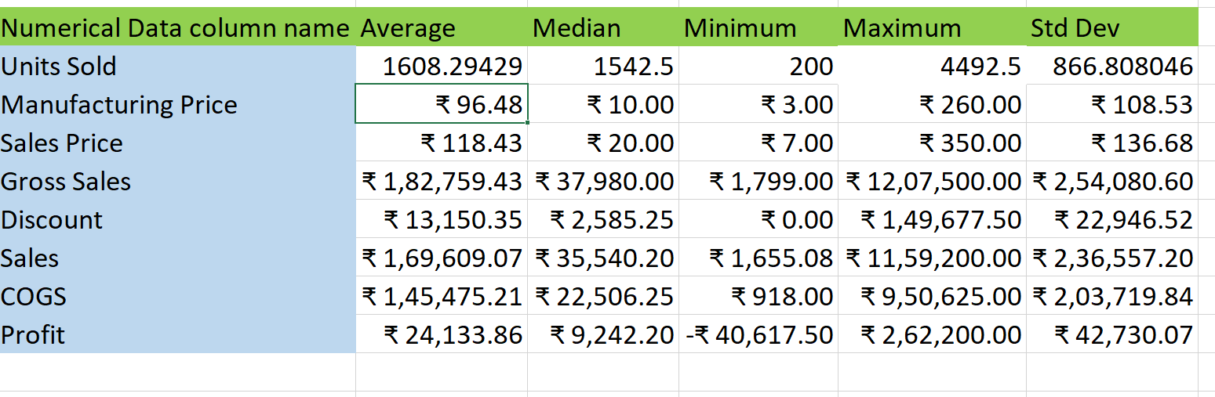
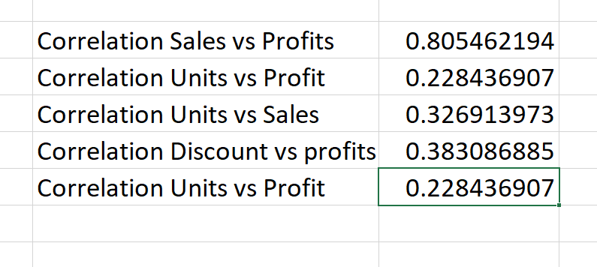
Statistical Analysis using Excel
In the initial section of data exploration and data summary, we found that the data is clean and has no missing values or so and hence there is no need of data cleaning for this data set. The data is clean. We will now proceed with the statistical analysis.
Descriptive Statistics : The mean, median, maximum and minimum values and the standard deviation of the various numerical values were found with the statistical analysis formulas and are reported to be as below.
B. Correlation Analysis
1. Positive Correlation: As one variable increases, the other variable also tends to increase. The correlation between Sales and Profit is 0.8, it implies that higher sales are generally associated with higher profits.
2. Strength: A correlation of 0.8 is close to 1, which signifies a strong relationship. While it doesn’t mean one variable causes the other to change (correlation ≠ causation), it shows they are closely related.
3. Here the next analysis between discounts and profits gives 0.3 which is close to 0, so it makes not much difference on the profits
4. The units sold and sales column is also giving us 0.3. So the sales value is depending more on the pricing than the volume of the good or products

Slide 6
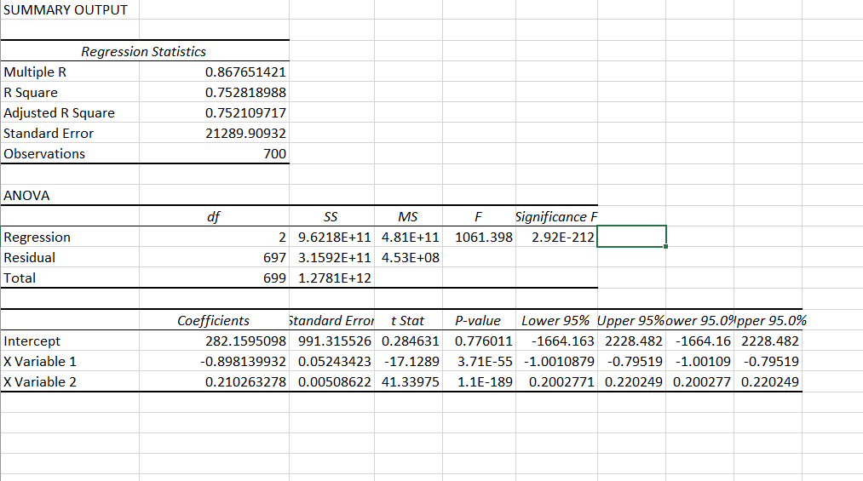
C. Regression Analysis
Determining how independent variables (e.g., Units Sold, Discounts- X variable) impact a dependent variable (e.g., Profit, Sales- Y variable).
Output Interpretation:
Regression Table Analysis
Multiple R (0.8677): This is the correlation coefficient. A value close to 1 indicates a strong positive relationship between the independent and dependent variables.
R Square (0.7528): This means that about 75.28% of the variation in profits is explained by the variation in units sold. This is a reasonably high value, indicating a strong model fit.
Adjusted R Square (0.7521): Since this value is almost identical to R Square, it suggests that adding additional independent variables may not significantly improve the model.
Standard Error (21289.90932): This shows the average deviation of the predicted profit values from the actual ones. Lower values are generally preferred.
Observations (700): This indicates that there are 700 data points in the regression analysis.

Slide 7
b. ANOVA Table Analysis
Significance F (2.92E-212): This shows the probability that the model’s fit happened by chance. A very small value here implies that the regression model is statistically significant overall.
c. Coefficients Table
Intercept (282.16): This is the predicted profit when units sold are zero. While meaningful mathematically, it might not always have a real-world implication.
X Variable 1 (-0.898): This coefficient suggests that for each additional unit sold, the profit decreases by approximately 0.898 units, assuming all other factors are constant. Negative Profit Per Unit Sold? This result may indicate either:
High production or operational costs per unit or The business model may have pricing or efficiency issues.
P-values (3.71E-55 for X Variable 1): The P-value associated with the independent variable is nearly zero, which is far below the conventional threshold of 0.05. This implies that units sold is a statistically significant predictor of profit.
Lower 95% and Upper 95% for X Variable 1 (-1.001 to -0.795): This confidence interval suggests that the true effect of each unit sold on profits lies within this range, providing evidence of a consistently negative impact.
Key considerations
The negative coefficient for units sold may indicate inefficiencies in sales processes, pricing, or cost structure.
The model explains about 75% of the variability in profits, which is strong but leaves room for other unexplained factors.
Units sold is a statistically significant factor affecting profit, but further investigation may be needed to address why increasing units sold lowers profit.

Slide 8
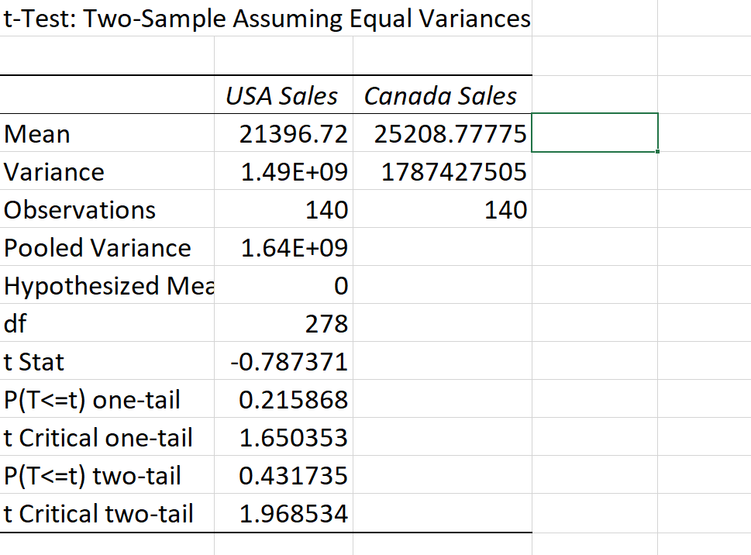
D. Hypothesis Testing
Performed between the profit values of Canada and USA
Two-tailed p-value: it’s 0.4. If 0.03 < 0.05, We fail to reject the null hypothesis, meaning there is not a significant difference between the profits of the USA and Canada.

Slide 9
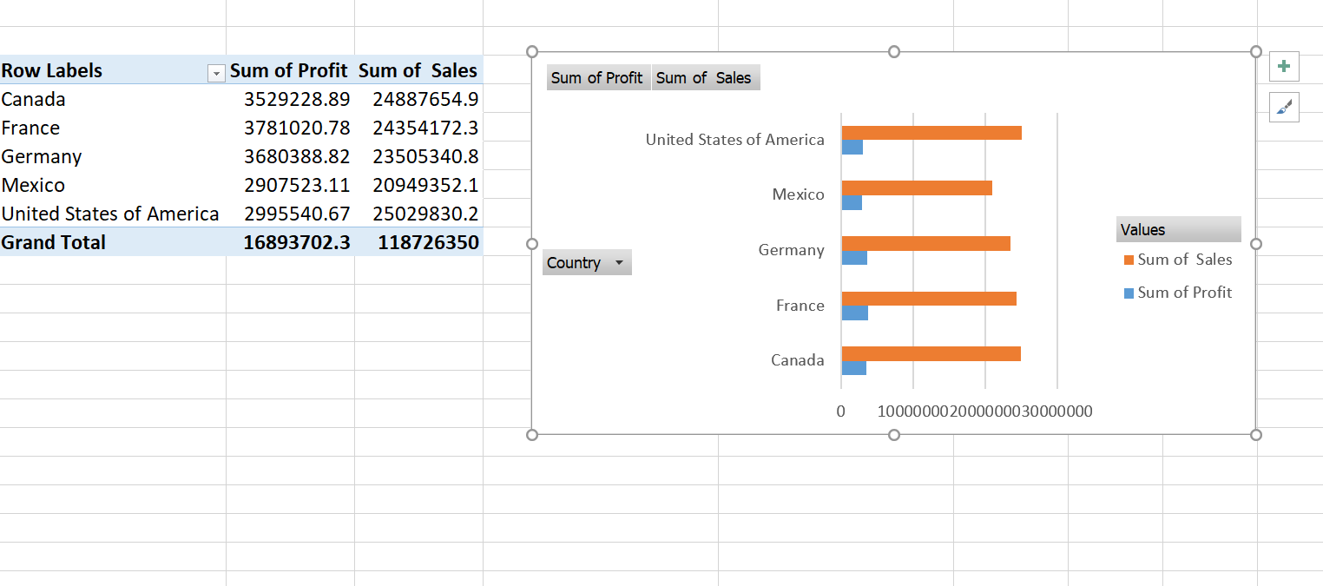
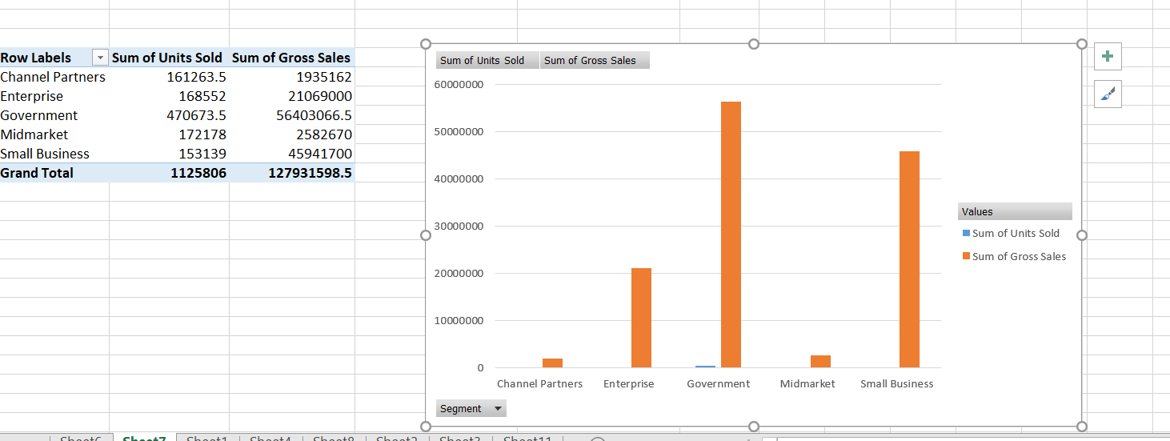
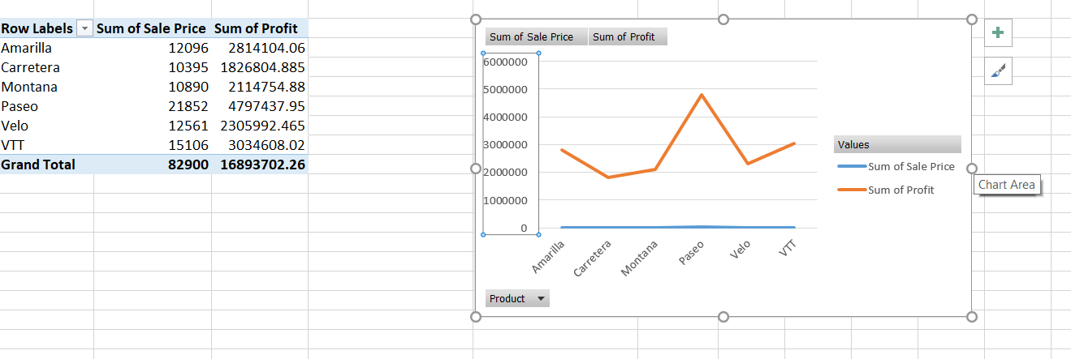
Graphical Analysis using Excel
Bar chart
1. Comparing Total Sales and Profit by Country
2. Comparing Total Units Sold and Gross Sales by Segment
3. Comparing Sales or Profit by Product category to see which performs best

Slide 10
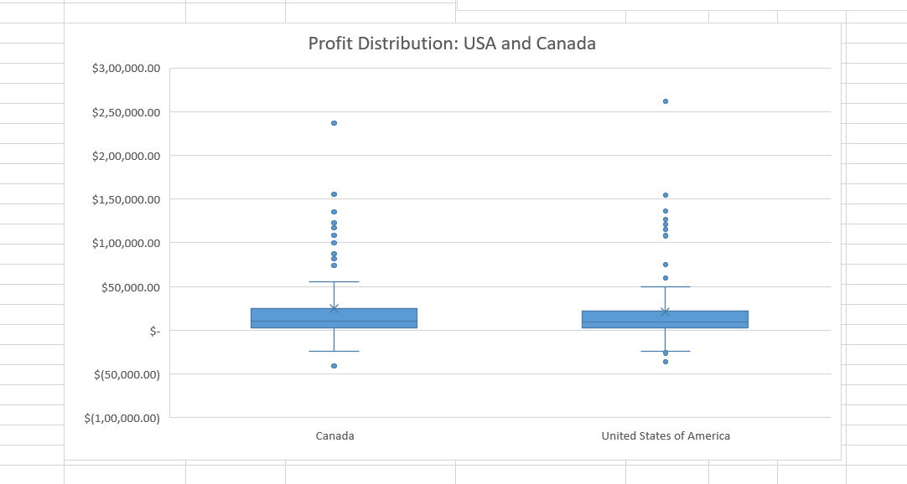
B. Box Plot
1. Box plot to compare Profit distribution between USA and Canada
1. The median is closer to the bottom of the box, it indicates that the Profit is skewed toward higher values (more higher profits). Smaller median box means that the values are more consistent and concentrated around the median
2. Median for Canada > Median for USA indicating higher average profits for Canada.
3. Box for USA is wider than the box for Canada, it indicates that Profit values in the USA have a larger spread, meaning there is more variation in the profits for USA.
4. Canada’s whiskers are longer, Canada’s profits are more spread out.
5. Outliers for USA are more compared to Canada indicating few exceptionally high values of profit for USA over Canada. But the number of whiskers for both the plots are almost the same.

Slide 11
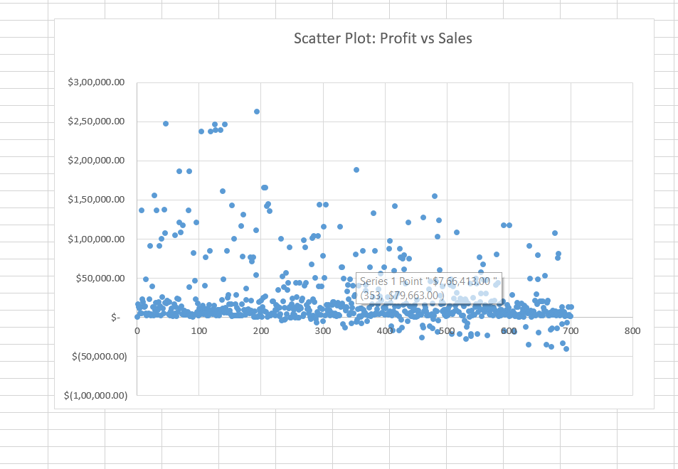
C. Scatter Plot
Profit vs Sales
Points at the Top (Few Outliers) These points represent transactions with high profits and sales. They are likely:
Exceptional sales events or premium product categories.
Niche, high-margin products.
One-off deals contributing significantly to profit.
Points Spread Across the Bottom (Concentration of Data)
Most of your transactions likely have lower profits despite possibly moderate or high sales.
This could be due to:
Discounting strategies eroding profit margins.
Higher operational or production costs.
Selling low-margin products in bulk.

Slide 12
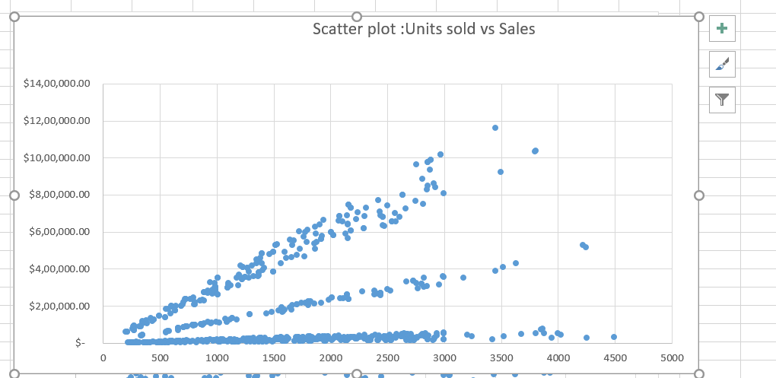
2. Units sold vs Sales
1. Horizontal Line at the Bottom (Flat Points)
These points represent sales transactions where the sales values remain similar despite increasing or varying units sold.
Possible Reasons:
Products sold at very low unit prices, causing minimal sales variation regardless of quantity sold.
The presence of heavily discounted products.
Errors in sales data where pricing information may be missing or incorrect.
2. Linearly Increasing Points from the Axis
Points starting at the axis and moving upwards in a linear pattern indicate a positive correlation between Units Sold and Sales.
Interpretation:
These points likely represent consistent product pricing:
As the number of units sold increases, sales increase proportionally.
3. Multiple Linear Clusters with Different Slopes
The presence of several lines with increasing slopes suggests:
Different product categories or pricing tiers.
Higher slopes indicate premium or expensive products, while lower slopes indicate lower-priced products.

Slide 13
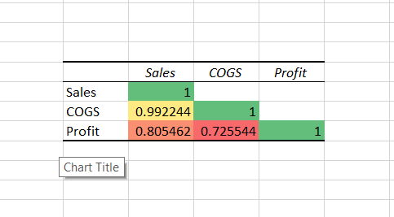
D. Heat Map
Interpreting the Heat Map and Correlation Table
Sales and COGS (0.99, Green)
Extremely high positive correlation (~1).
Indicates that COGS tightly follows Sales, which is natural since more sales usually mean more production costs.
Sales and Profit (0.80, Orange/Red)
Strong positive correlation.
Suggests that while higher sales typically result in more profit, costs or discounts may be moderating profits.
COGS and Profit (0.72, Orange)
Moderate correlation.
Implies that profit is not purely driven by COGS efficiency alone but by a combination of factors, possibly including pricing strategy and discounts.

Slide 14
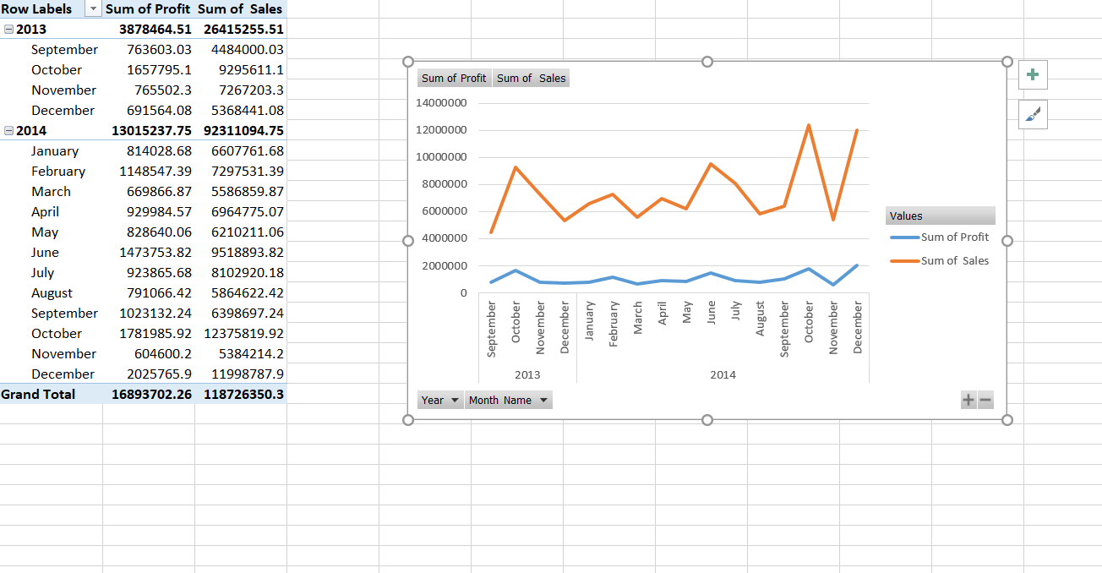
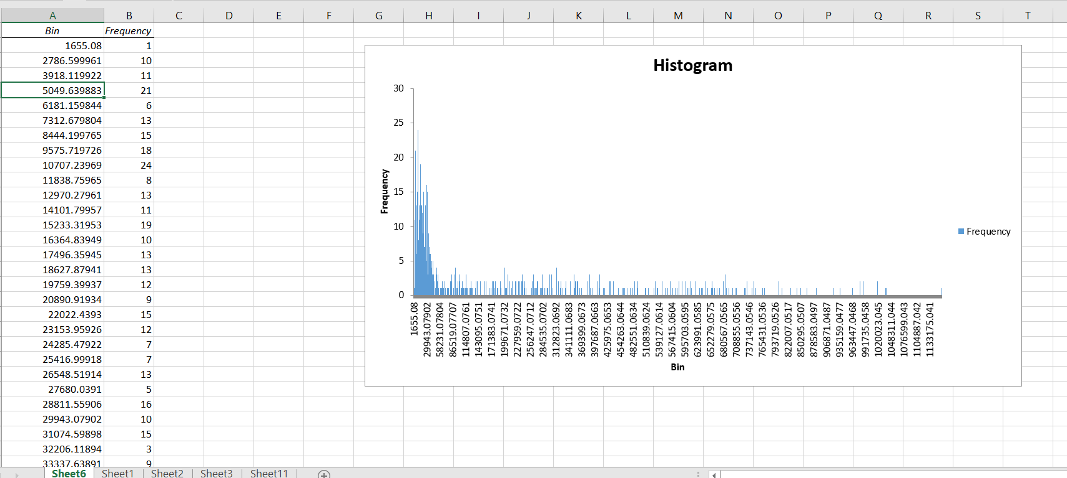
E. Line chart for year and month wise sales and profits
The sales are highest during the October and December of 2014 and are the lowest in September to December 2013 and also during December 2014. The profits almost had an equal distribution while there were little higher profits in June 2014 and December 2014 and were the least during November 2013 and 2014.
F. Distribution Analysis using Histogram chart

Slide 15
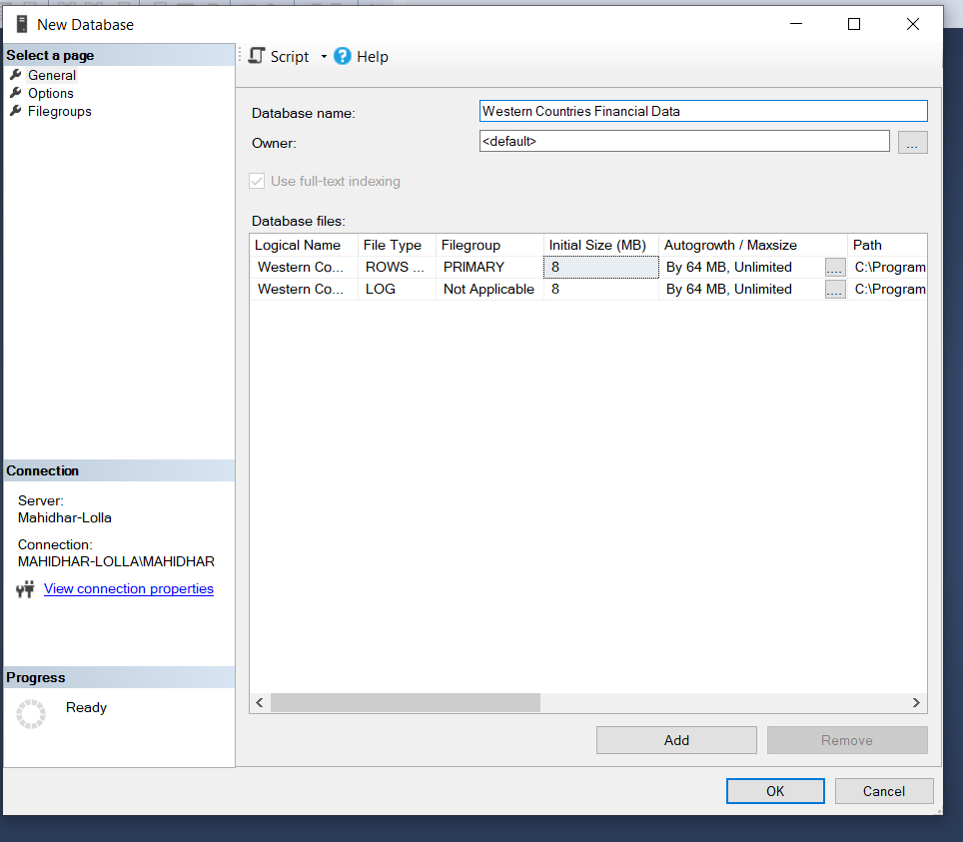
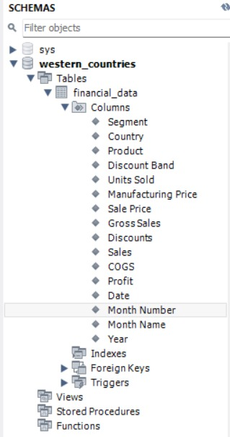
Insert the given data into the SQL server
Inserting given Data into SQL Server and checking for the table schemas

Slide 16
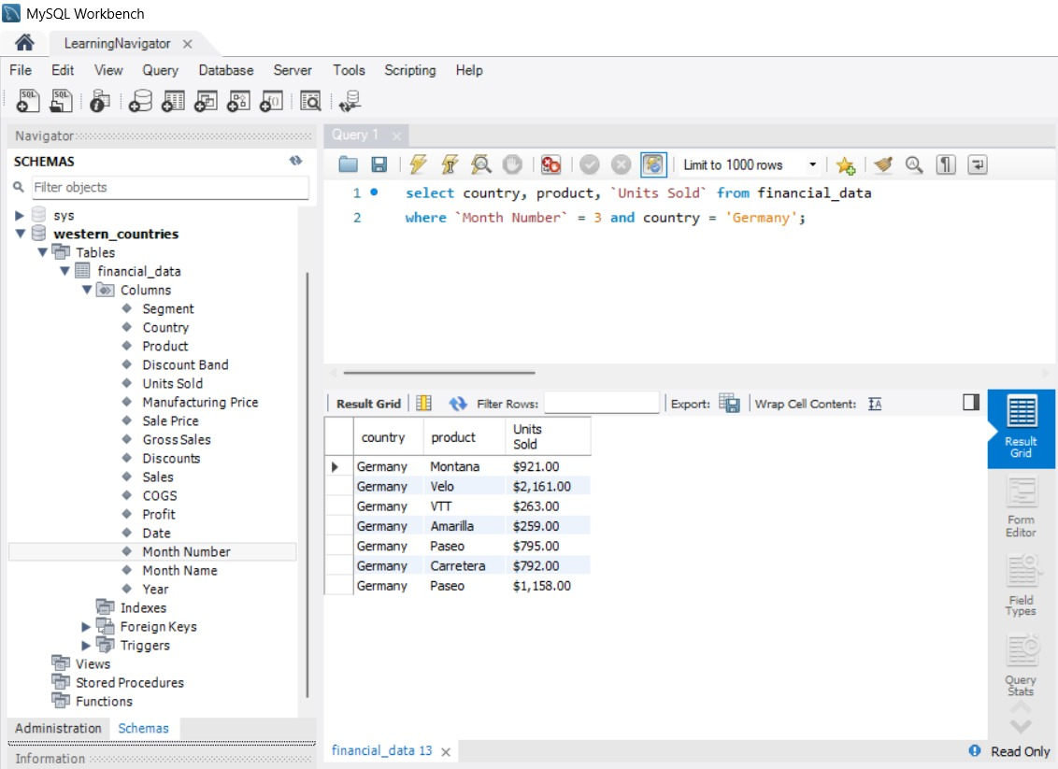
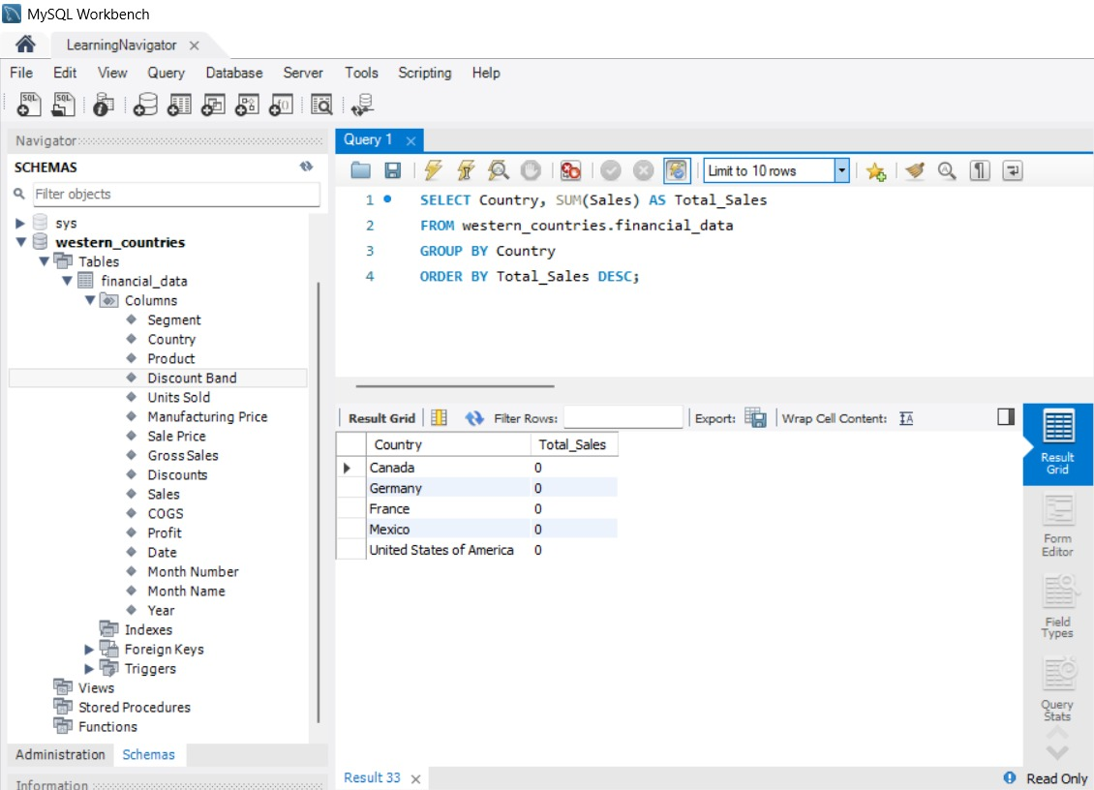
Running Queries to check the correct import of data from Excel to SQL

Slide 17
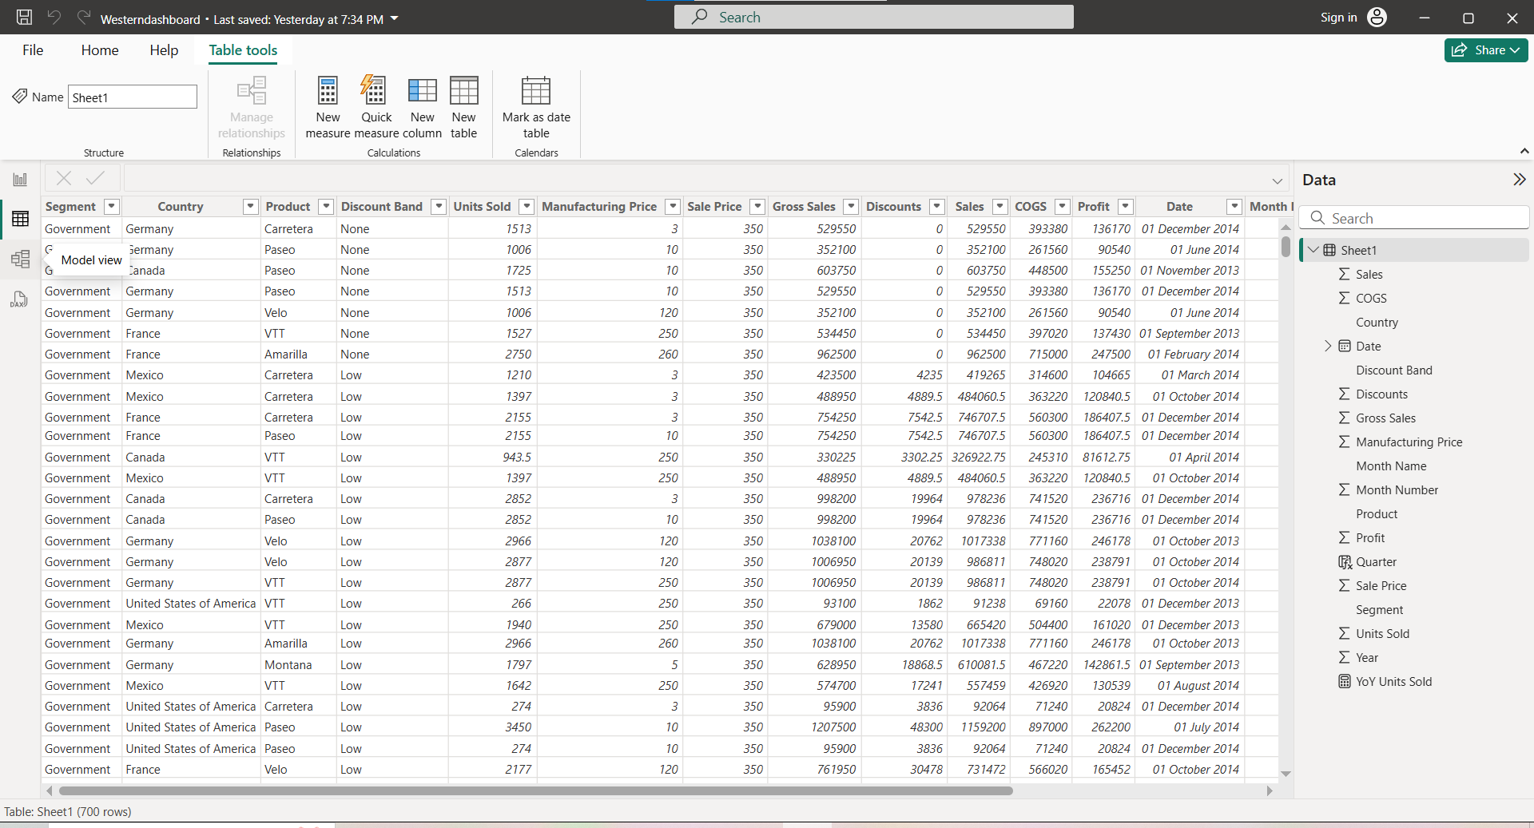
Import the Data from the SQL Database into PowerBI

Slide 18
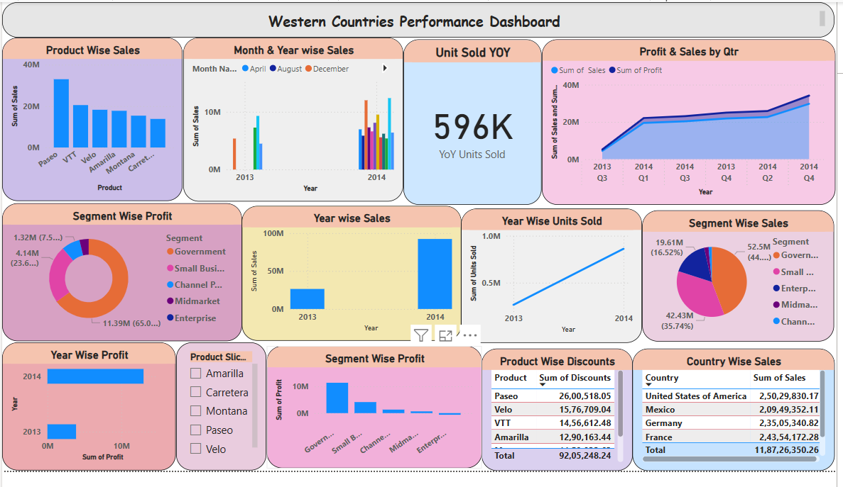
Interactive Dashboard by using visualization tools
Dashboard made Using Microsoft Power BI

Slide 19
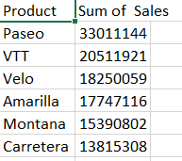
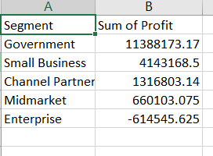
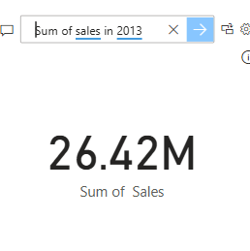
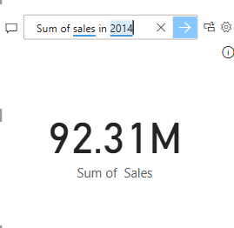
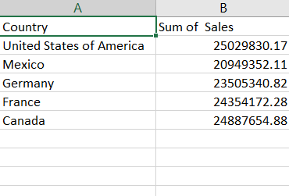
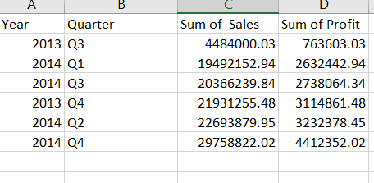
Conclusion and Inferences
1. Product wise Sales
3. Yearly sales
2. Segment wise Profit
4. Country wise Sales
5. Profit and sales by Qtr

Slide 20
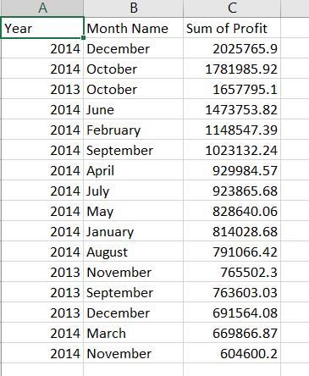
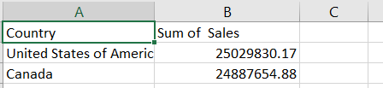
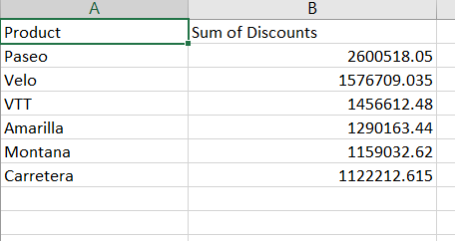
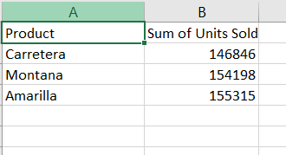
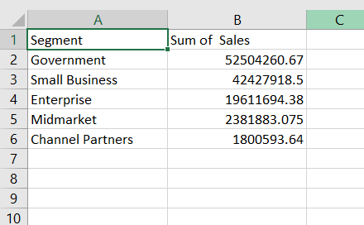
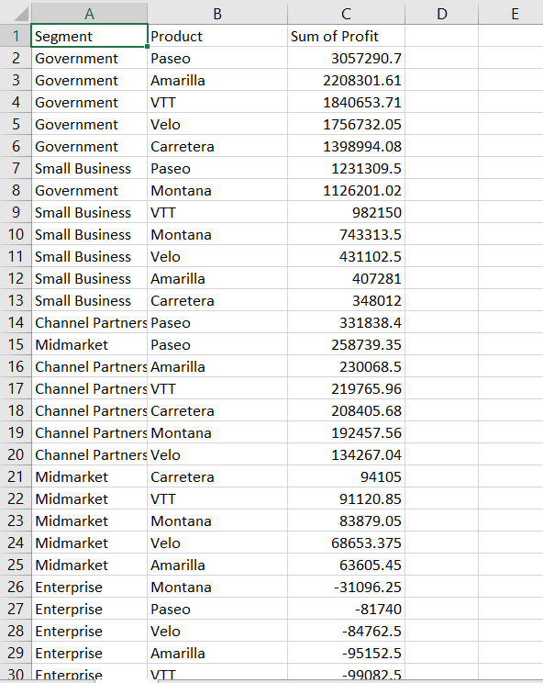
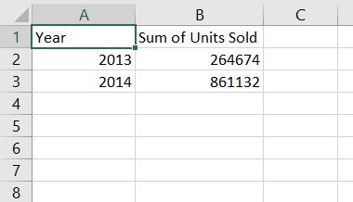
6. Month wise Yearly profit
7. Top2 countries by Sales
10. Product wise discount
8. Bottom 3 products by sales
11. Segment wise Product Sales
12. Segment wise product wise profit
9. No.of units sold year over year

Slide 21
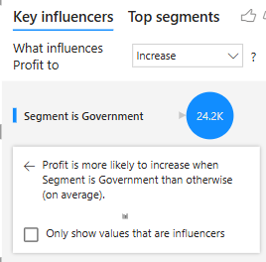
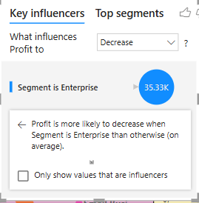
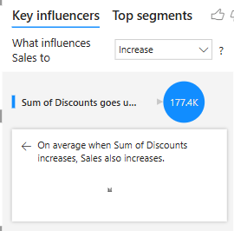
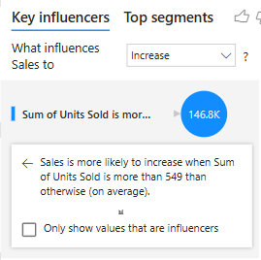
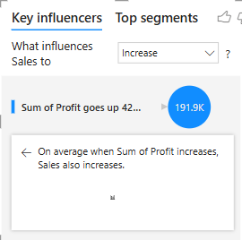
Some more conclusions and Inferences
﻿﻿Sum of Units Sold for 2014 (861132) was higher than 2013 (264674).﻿﻿ ﻿﻿ ﻿﻿
Paseo accounted for 27.80% of Sum of Sales.﻿﻿ ﻿﻿ ﻿﻿
Across all 6 Product, Sum of Sales ranged from 1,38,15,307.89 to 3,30,11,143.95.﻿﻿ ﻿﻿ ﻿﻿October had the highest total Sum of Sales at 2,16,71,431.02, followed by December, November, and September.﻿﻿ ﻿﻿ ﻿﻿
2014 in Month Name October made up 10.42% of Sum of Sales.﻿﻿ ﻿﻿
﻿﻿Sum of Sales and total Sum of Profit are positively correlated with each other.﻿﻿ ﻿﻿ ﻿﻿
Average Sum of Sales was higher for 2014 (2,30,77,773.69) than 2013 (1,32,07,627.76).﻿﻿ ﻿﻿ ﻿
Some Key Influencers

Slide 22
Endnotes
Reference Links:-
Links for Excel file, PowerBI file
Excel file Google drive Link: https://docs.google.com/spreadsheets/d/19BuVeeg7xmg1gjga7_hUyhdCcXx5F2yK/edit?usp=sharing&ouid=117434846434771070388&rtpof=true&sd=true
Power BI Google drive Link:
https://drive.google.com/file/d/1HOZmQEmPDQtdNUUZFQDY3V48SuS4o-dJ/view?usp=sharing

